Slide 1
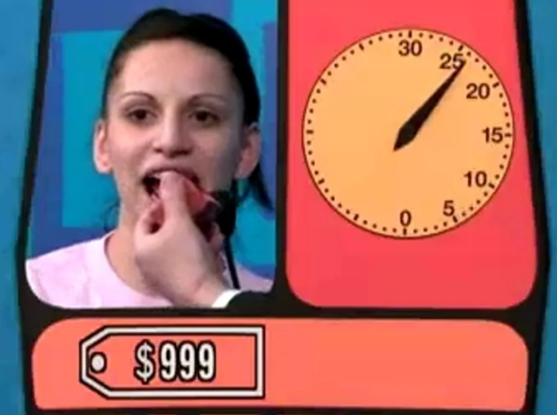
Demonstration: HiLo
The Price is Right, Clock Game

Slide 2

import tornado.ioloop
import tornado.web
import random
class HiLo(tornado.web.RequestHandler):
myNumber = 50 # Useful for debugging.
def get(self):
guess = self.get_argument("guess", None)
if not guess:
self.write("I am thinking")
HiLo.myNumber = random.randrange(1,100)
elif int(guess) > HiLo.myNumber:
self.write("Lower")
elif int(guess) < HiLo.myNumber:
self.write("Higher")
else:
self.write("You got it")
if __name__ == "__main__":
handlers = [("/hilo", HiLo)]
app = tornado.web.Application(handlers)
app.listen(80)
tornado.ioloop.IOLoop.current().start()

Slide 3
def get(self):
self.write("""
<!DOCTYPE html>
<html>
<head>
<meta charset="UTF-8">
<title>Hi Lo</title>
</head>
<body>
""")
guess = self.get_argument("guess", None)
...

Slide 4
if not guess:
self.write("<h1>Try to guess my number!</h1>")
HiLo.myNumber = random.randrange(1,100)
elif int(guess) > HiLo.myNumber:
self.write("<h1>Lower</h1>")
elif int(guess) < HiLo.myNumber:
self.write("<h1>Higher</h1>")
else:
self.write("<h1>You got it!</h1>")

Slide 5
self.write("""
<form>
Your guess: <input name="guess" autofocus> </br>
<input type="submit">
</form>
<br>
<a href="/hilo">Start new game</a>
</body>
</html>
""")

Slide 6
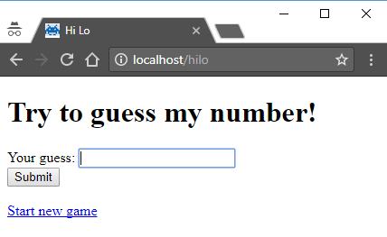
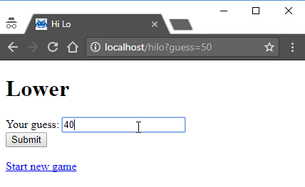

Slide 7
Complete Code
import tornado.ioloop
import tornado.web
import random
class HiLo(tornado.web.RequestHandler):
myNumber = 50 # This gets set below. Useful for debugging.
def get(self):
self.write("""
<!DOCTYPE html>
<html>
<head>
<meta charset="UTF-8">
<title>Hi Lo</title>
</head>
<body>
""")

Slide 8
Complete Code
guess = self.get_argument("guess", None)
if not guess:
self.write("<h1>Try to guess my number!</h1>")
HiLo.myNumber = random.randrange(1,100)
elif int(guess) > HiLo.myNumber:
self.write("<h1>Lower</h1>")
elif int(guess) < HiLo.myNumber:
self.write("<h1>Higher</h1>")
else:
self.write("<h1>You got it!</h1>")

Slide 9
Complete Code
self.write("""
<form>
Your guess: <input name="guess" autofocus> </br>
<input type="submit">
</form>
<br>
<a href="/hilo">Start new game</a>
</body>
</html>
""")
if __name__ == "__main__":
handlers = [("/hilo", HiLo)]
app = tornado.web.Application(handlers)
app.listen(80)
tornado.ioloop.IOLoop.current().start()

